Slide 1
Mental Health Matters
Jaren Doby, MSW, LCSW

Slide 2
Agenda
History of Mental Health
Mental Health Stats and Facts
What Do We Do Next?
Questions & Wrap-Up

Slide 3
About Me
Jaren Doby is a psychotherapist currently credentialed as a Licensed Clinical Social Worker (LCSW) with more than 14 years of experience in the mental health field. Jaren currently practices as an Outpatient Mental Health Therapist in the state of North Carolina.

Slide 4
History of Mental Health

Slide 5
Initial attempts to treat mental illness dates back as early as 5000 BC.
Trephined skulls in regions that were home to ancient world cultures were discovered.
The belief was that mental illness was the result of supernatural phenomena such as spiritual or demonic possession, sorcery, or an angry deity.

Slide 6
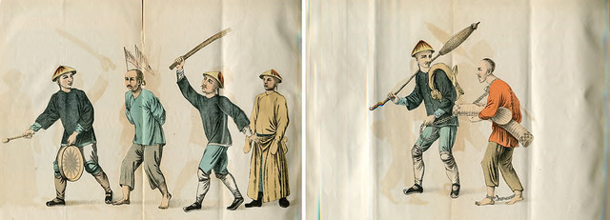
The early response and approach was with mystical and sometimes brutal treatments.
Other means attempted to appeal to the spirit by way of threats, bribery, punishment, and submission.
Exorcisms, spells/charms, prayer, atonement, in addition to other rituals were used to drive out evil spirits.

Slide 7
Ancient Egyptians were discovered to have approaches in their treatment of mental illness. Encouraged recreational activities such as concerts, dances, and painting in order to relieve symptoms and achieve some sense of normalcy.
- Advancements by the Egyptians in medicine, mathematics, and knowledge of the human body aided in their initial approaches in treatment.

Slide 8
Around 400 BC Greek physician Hippocrates challenged the belief that mental illness was caused by supernatural forces
Insisted that mental health related issues were related to issues in the brain and should be treated as a medical illness.

Slide 9
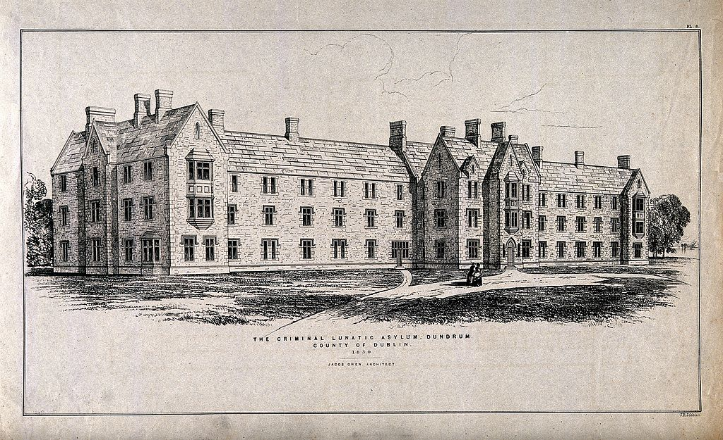
Mental Health Over Time
1600’s
Isolation of those with mental illnesses. Those that are considered mentally disturbed were chained and kept in inhumane conditions.
Talisman and amulets were popular utilizing various stones, wrapped in brass or tin with astrological signs etched into them. Even being cast at astrologically significant times. Traditionally worn around the neck of the afflicted while they recited prayers.
1700’s
Increase in the use of asylums that acted as facilities to house and treat the mentally ill.

Slide 10
A Dark Page in Mental Health History
Asylums and The Normalizing of Stigmas

Slide 11
“Insane Asylum”
Inhumane treatment of patients within facilities.
Practices included isolation, starvation, and experimental procedures.
Initially staffed with untrained and unqualified staff that aided in the further ill treatment of patients.
Patients were known to be chained/ strapped to beds and forced to sit amongst their own waste.

Slide 12
Challenges for Change in the 1800’s
1800’s
- Increase in mental health reform aided in the attention and increase in mental health institutions.
- Seeing mentally ill patients being jailed in inhumane conditions to prevent any conflicts with other inmates.
- Dorothea Dix charged campaign to reform asylums called the Mental Hygiene Movement, in addition to advocating, raising funds and challenging changes in proper mental health care.

Slide 13
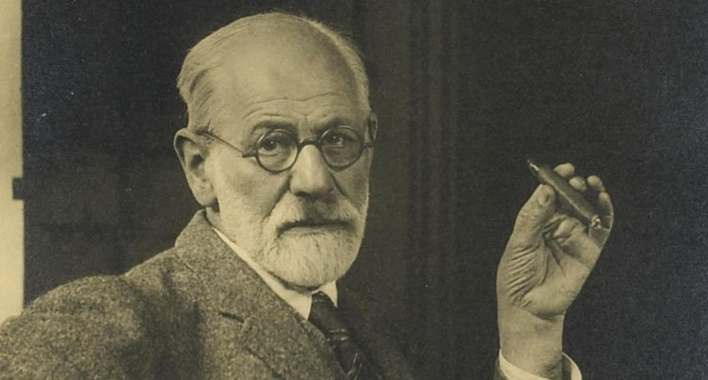
Sigmund Freud
Founder of Psychoanalysis
Clinical method for evaluating and treating pathologies in the psyche through dialogue between a patient and a psychoanalyst.
Developed theory of psychosexual development.

Slide 14
Mental Health in The 20th Century
Early1900’s
-Psychoanalysis gains traction as the main treatment approach.
-Patients in institutions have limited to no access.
1930’s
Treatment options expand to the uses of:
-Drugs
-Electroconvulsive therapy
-Surgical Procedures
-Medically Induced Coma
1940’s
National Mental Health Act established to increase research relating to psychiatric disorders and to aid in the development of more effective methods of prevention, diagnosis, and treatment of such disorders.
Mid 1940’s
1950’s
- Further development and use of psychiatric medications in order to treat mental health relates issues.
Lithium introduced in order to aid in the treatment of psychosis.

Slide 15
The Gift and The Curse
1960’s
-The Community Mental Health Act of 1963 established to provide federal funding for community mental health centers and research facilities in the United States. This legislation was passed as part of John F. Kennedy's New Frontier. It led to considerable deinstitutionalization and helped replace large asylums.
- Psychiatric medications aided in deinstitutionalization, but lead to the cause of Revolving Door Syndrome.
-The tendency of clients to get better for a while, and then end up relapsing. It most often applies to those with serious disorders.
- Increase in homelessness of mentally ill individuals.

Slide 16
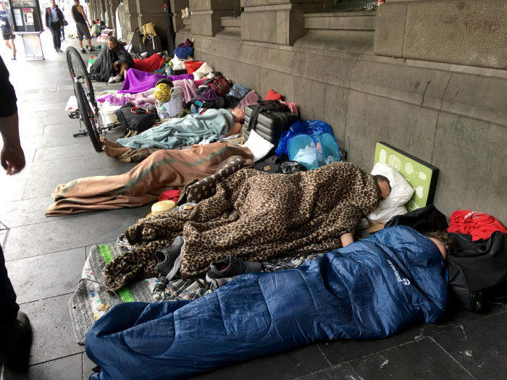
1980’s
-Supplemental income is provided by the government for individuals suffering from mental illnesses considered to be chronic.
Estimated that one-third of all homeless individuals in America were considered severely mentally ill. Lack of support and guidance led to the incarceration of over 100,000 mentally ill individuals in America as well.
1990’s
More effective psychiatric medications are developed and used in the decrease and management of mental health related symptoms
In the early 1990’s, 7.2% of the inmate population was considered seriously mentally ill. Over one-fourth of the inmate population detained without charges until there was open availability in a mental hospital.

Slide 17
The Current State of Mental Health in the Modern World
What Do The Numbers Say?

Slide 18
Did You Know?
1 in 4 Adults in the United States Experience Mental Illness.

Slide 19
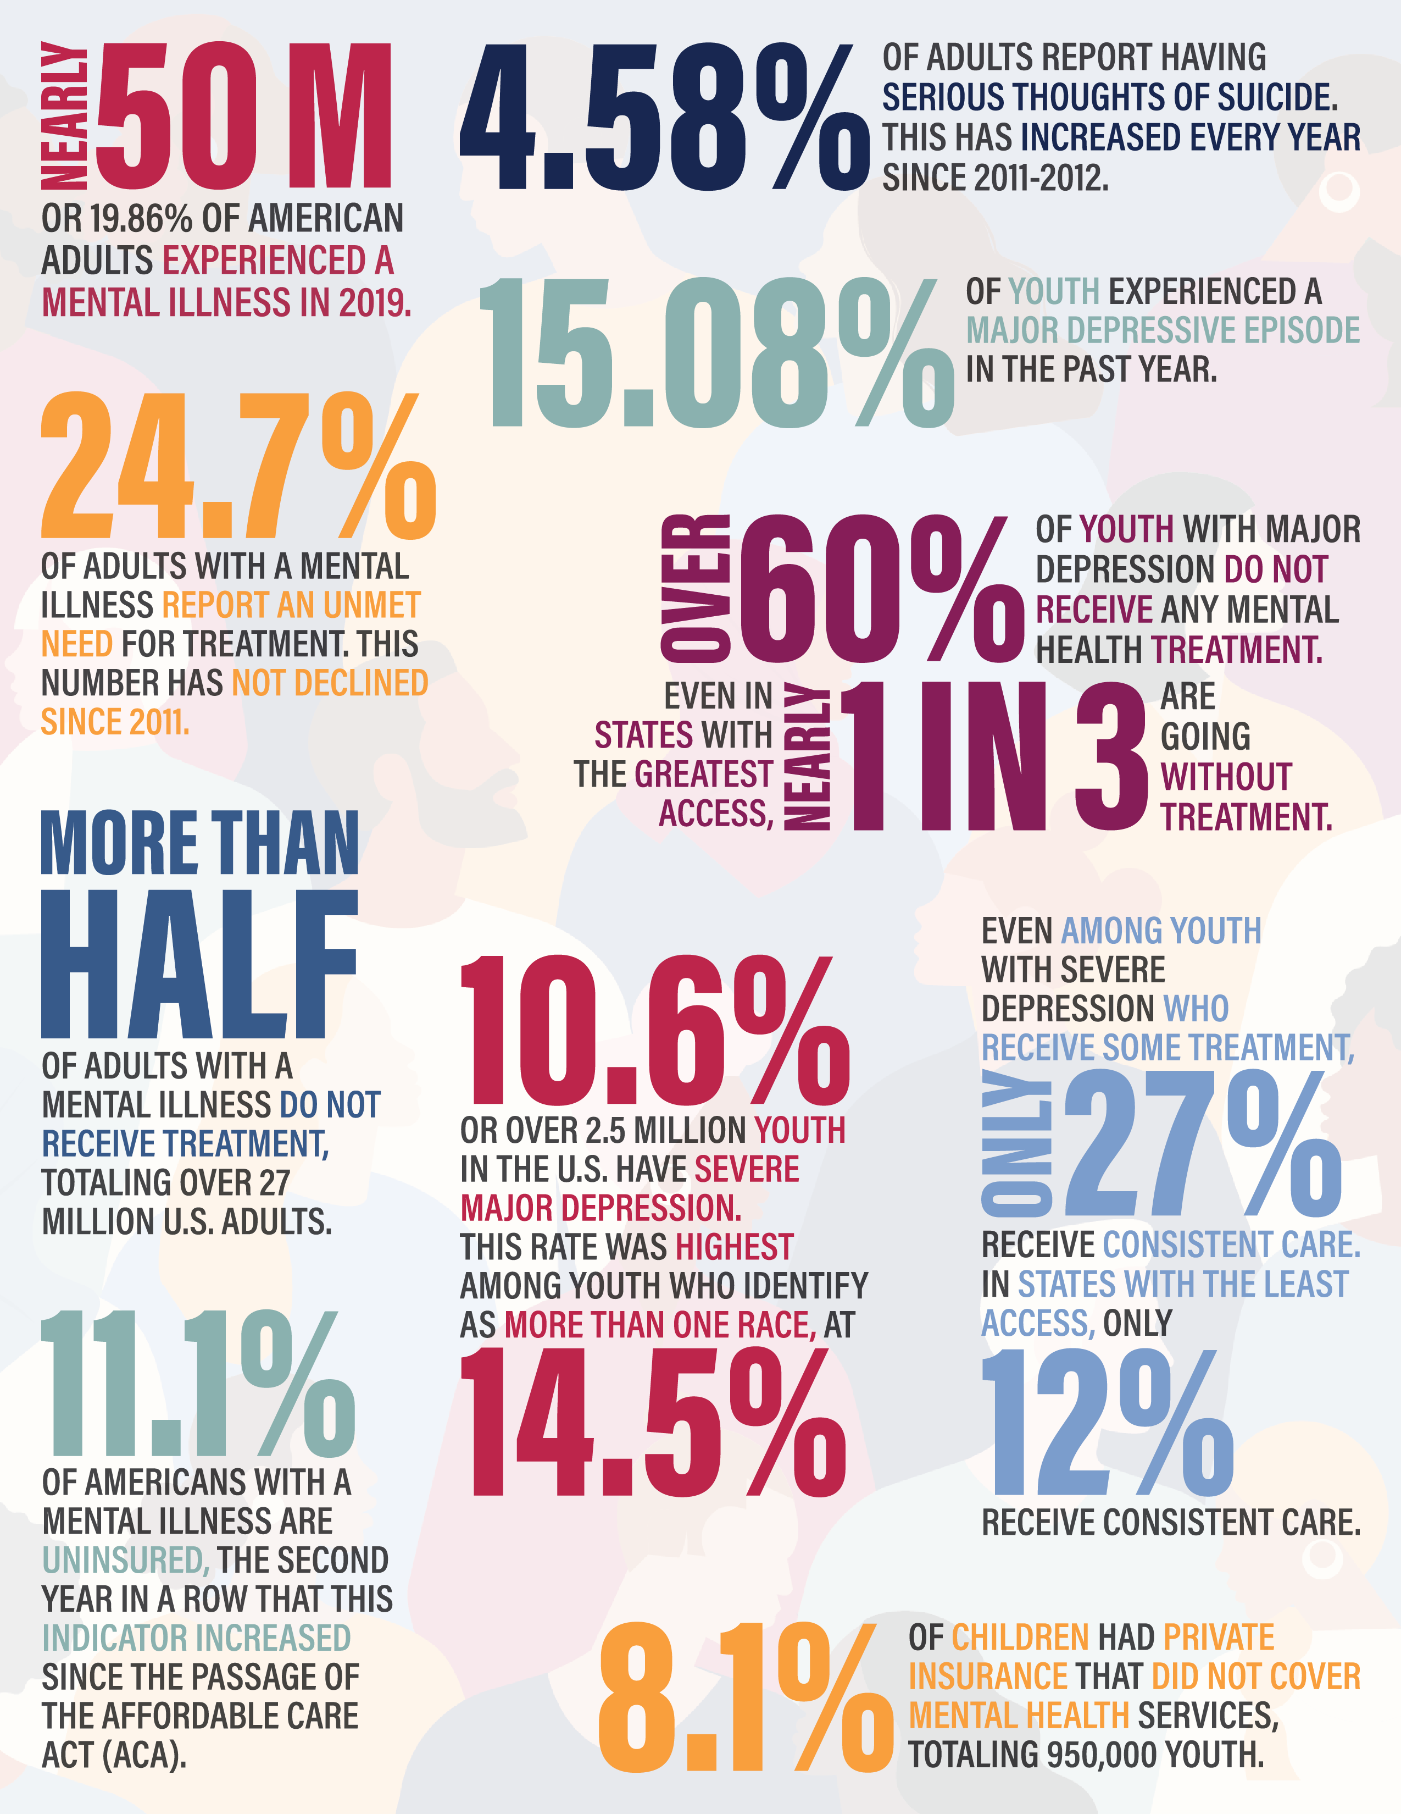

Slide 20
How Does Mental Health Impact Children and Young Teens?
Generation Z (Born around 1997-2012)
Gun violence is the top source of stress across all generations
75% of Gen Z reported mass shootings as a significant source of stress, and 72% said the same about school shootings
Around 56% of those who are in school say they experience stress when considering the possibility of a school shooting
More likely to report mental health conditions than any other generation.
Generation may be more tuned in to recognizing issues with their mental health than older generations.
Between March and October 2020, the percentage of emergency department visits for children with mental health emergencies rose by 24 percent for children 5 to 11 years old and by 31 percent for children and teens 12 to 17 years old
Early in 2021, there was a more than 50 percent surge in emergency department visits for suspected suicide attempts among girls 12 to 17 years old
As of June 2021, more than 140,000 children had lost a caregiver to COVID-19

Slide 21
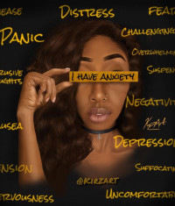
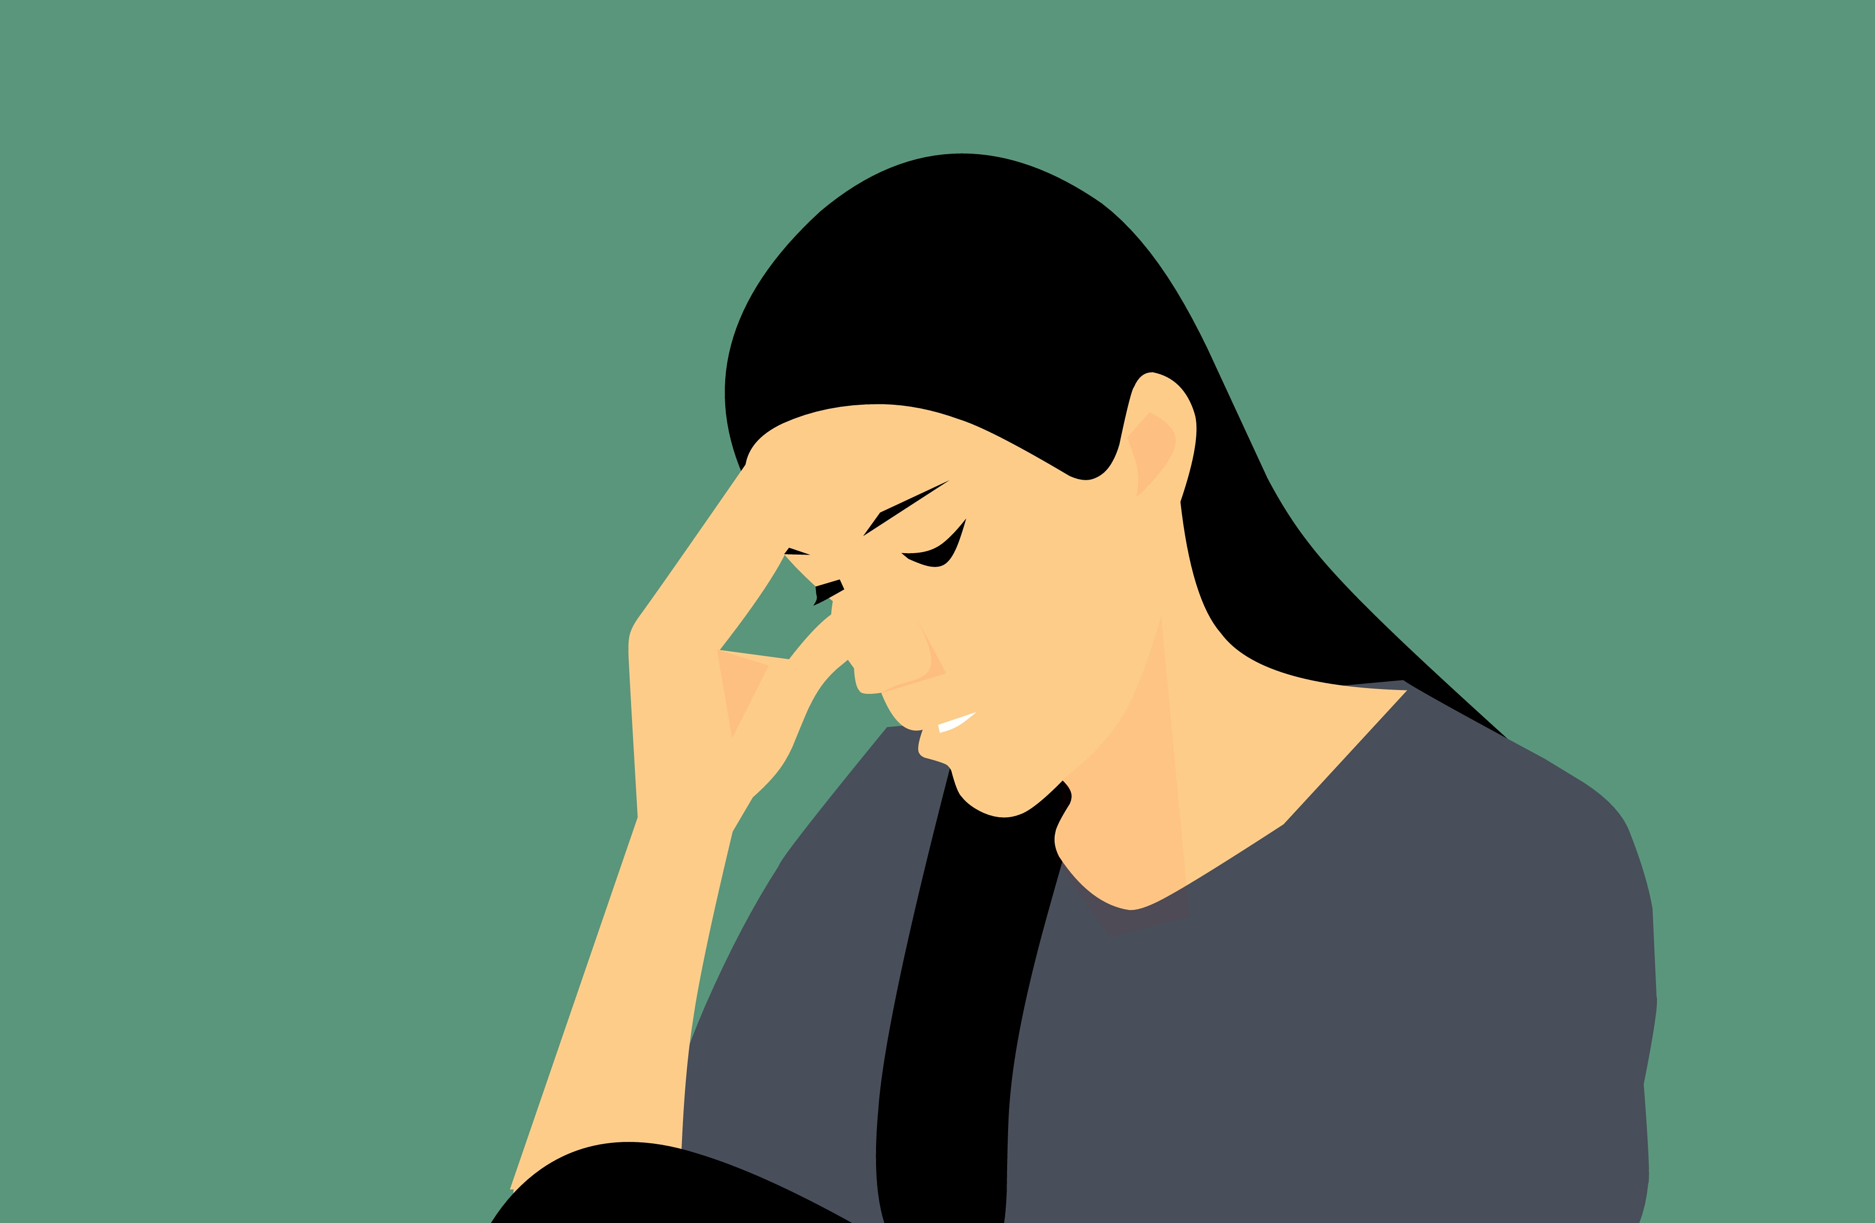
Mental Health in Minorities
Use of psychiatric emergency services rather than community support services.
Involuntary hospitalizations as a result of seeking care.
Emergency treatment as a result of interactions with law enforcement.
Over-diagnosis of psychosis related disorders.
Higher doses of antipsychotic medications.
Mental health stigma, past and present structural racism, and limited availability of resources are contributing factors of compounding mental health issues.
Lack of cultural competency by providers.

Slide 22
How Do We Recognize The Signs?
Changes in behavior/mood
Sleep disturbance (Sleeping too much, not resting well)
Changes in appetite (overeating or lack of appetite)
Changes in energy level (Fatigue, dramatic increase in energy)
Anhedonia (low pleasure/interest in doing things that they enjoy)
Problems concentrating
Restlessness or issues with being able to relax.
Increased anxiety/worry out of proportion to the given situation.
Feeling bad about themselves.
Giving away of valued items.
Engagement in self harming behaviors
Excessive spending, promiscuity, excessive drinking/drug use, physical activities that can lead to harm, etc.
Suicidal/Homicidal ideation
Auditory/Visual Hallucinations
Issues with adjustment to changes

Slide 23
What Do We Do Next?
Increase awareness related to mental health.
Utilize/Share resources.
Don’t ignore the signs.
Develop and make use of a positive self care routine.
Remember that we are better together than we are alone.
We need YOUR help!

Slide 24
Questions/ Discussion

Slide 25
Thank You
Jaren Doby, MSW, LCSW
jaren.doby@gmail.com
www.JarenDoby.com

